Slide 1
FLAC
MUMT 621 - Sam Vafaei

Slide 2
FLAC
Free lossless audio codec
Developed in 2000 by Josh Coalson
Incorporated under the Xiph.org banner in 2003
Latest release in 2007
Claims to be the fastest and most widely supported losses audio codec

Slide 3
The FLAC project
The stream format
The container format
libFLAC
libFLAC++
Command-line program for en/decoding
Command-line program for metadata editing
Plug-ins for music players

Slide 4
Features
Lossless
Asymmetric (slow encode, fast decode)
30-60% of original size
Open format
Royalty-free licensing
Patent free
DRM free
Supports tagging, album art, fast seeking, streaming and ReplayGain

Slide 5
Support
Windows, MacOS, Linux
Winamp, XMMS, foobar2000, musikCube
Sonos, Sqeezebox, Astell & Kern, Olive
Google Play and Android
Not supported by Windows Media Player, iTunes and iDevices

Slide 6
Specifications
Supports fixed-point samples only
PCM bit resolution of 4-32 bit
Sampling rate of 1-655,350 Hz
1-8 channels with an 5.1 option
Uses CRC checksums for streaming
Uses Vorbis comments system for tagging
Supports Rice parameter between 0 and 16

Slide 7
Architecture
Blocking
Interchannel Decorrelation
Prediction
Residual coding

Slide 8
Blocking
The input is broken up into many contiguous blocks.
Varies in size. If too small, excess bits will be wasted on frame headers. If too big, prediction will be negatively affected.
The optimal size of the block is usually affected by the sample rate and spectral characteristics of the source
Usually 500-1000 samples

Slide 9
Interchannel Decorrelation
Independent
Mid-side
Left-side
Right-side
Left-side and Right-side are the most efficient

Slide 10
Prediction
The block is passed through a prediction stage where the encoder tries to find a mathematical description.
Verbatim: No prediction, no compression
Constant: Signal is DC. Run-length coded.
Fixed Linear prediction
FIR Linear prediction

Slide 11
Residual coding
If the predictor does not describe the signal exactly, the difference between the original signal and the predicted signal must be coded losslessly.
Prediction + residual of the signal is smaller than the signal
Coded using Rice scheme

Slide 12
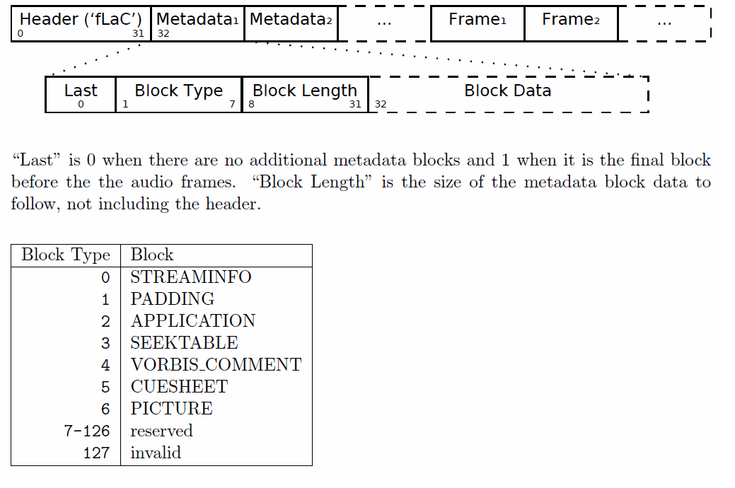
File System
Langenberger (2010)

Slide 13
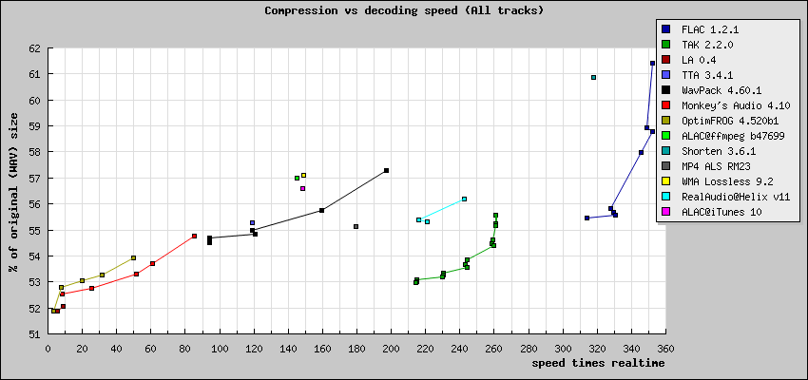
Comparison – Decoding Speed
Coalson (2008)

Slide 14
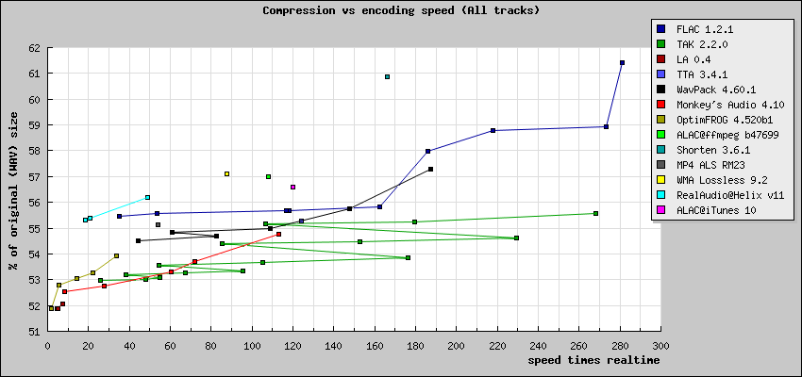
Comparison – Encoding Speed
Coalson (2008)

Slide 15
Thank you

